Slide 1
Team A
Presentation

Slide 2
INDEX
1. SEQUENCE
2. WEB & DEMO
3. APP & DEMO

Slide 3
Sequence

Slide 4
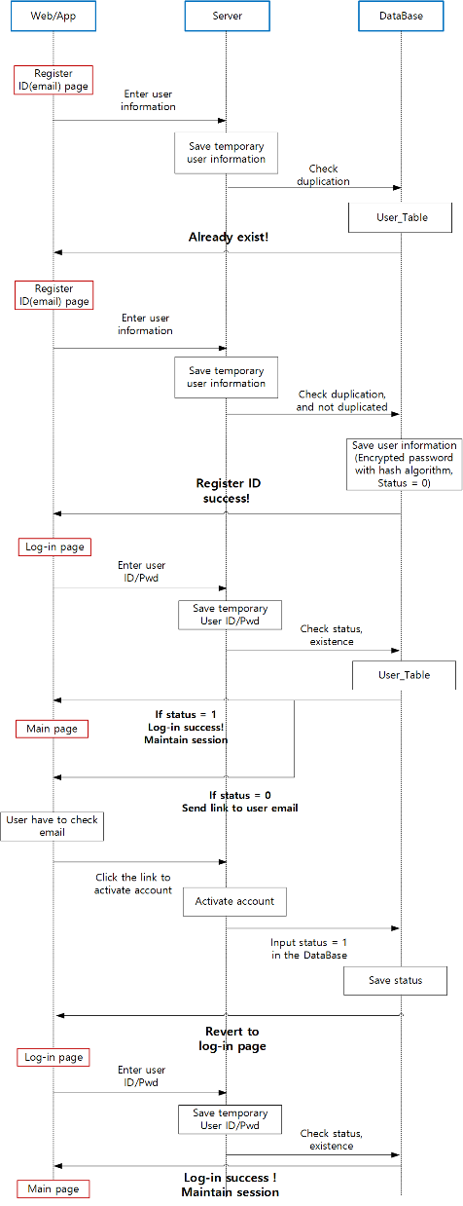

Slide 5
Web & Demo

Slide 6
App & Demo

Slide 7
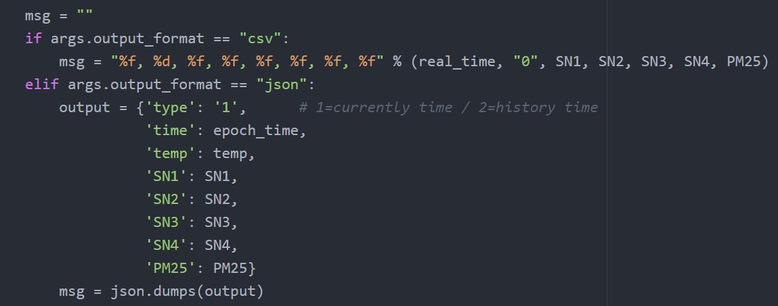
Use Jason form

Slide 8
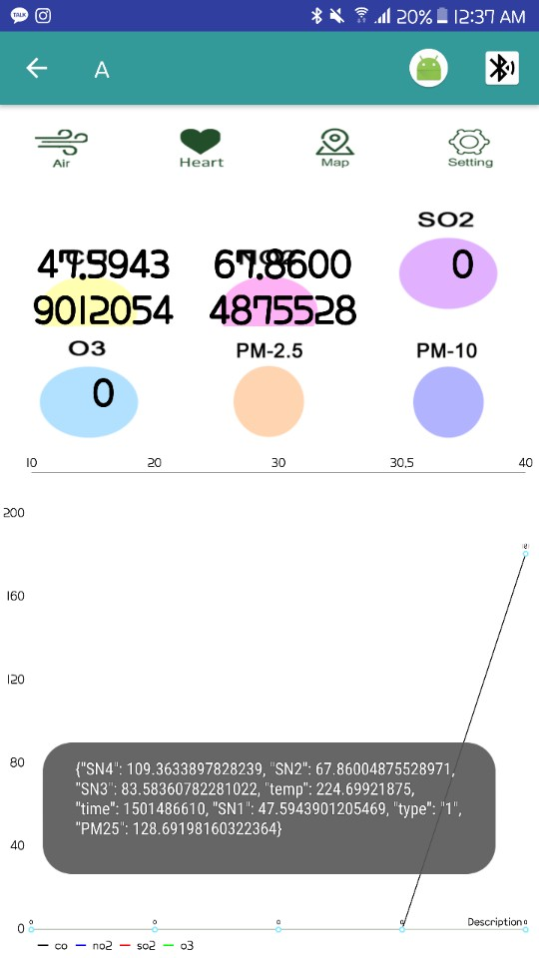
Use Jason form

Slide 9
Thank you

